Slide 1
Language Runtimes for Parallel Programming: Weak Memory and Program Order
Sylvan Clebsch
Microsoft Research, Cambridge UK
WGLD 2018

Slide 2



Pony
Statically typed, capabilities secure
Isolation and immutability, statically data-race free
Actor-model concurrency
Zero-copy messaging
No-stop-the-world GC, no read/write barriers
Native code, C-like performance
Lock free language, lock free runtime
http://ponylang.org

Slide 3
Writing Languages is Fun!
Parsers, symbol tables, type checkers, optimisers, code generators – these are all normal, well-typed, sensible program modules.
Turn some text into a tree, iteratively produce new trees, turn that last tree into some text (IR/assembly/machine code): programming languages are basically optimised for writing programming languages.
There are techniques for doing this quickly, different techniques for doing this verifiably, still different for doing this in a resource constrained environment; but they are all normal, well-typed, sensible program modules.

Slide 4
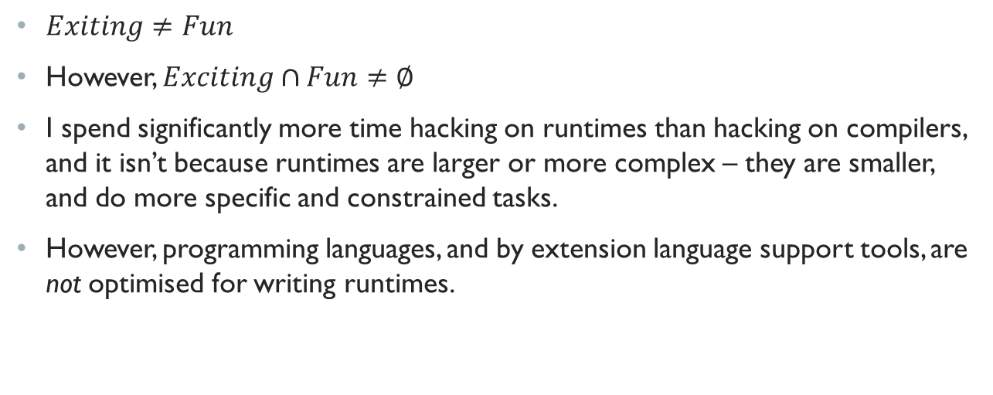
Writing Runtimes Is… Exciting?
$Exiting≠Fun$
However, $Exciting∩Fun≠∅$
I spend significantly more time hacking on runtimes than hacking on compilers, and it isn’t because runtimes are larger or more complex – they are smaller, and do more specific and constrained tasks.
However, programming languages, and by extension language support tools, are not optimised for writing runtimes.

Slide 5


What Do I Mean By “Runtime”?
Concurrency primitives
Memory allocator
Garbage collector
Scheduler
Asynchronous I/O
Timers
Maybe JIT?

Slide 6
Proposal: A Language For Runtimes
Runtime authors tend to use some combination of C, C++, and assembly (although these are not the only options).
They have to know what features of the language can’t be used, i.e. anything that depends on the language’s existing runtime (heap allocation, virtual dispatch, exception handling, RTTI, etc.).
Some common patterns include casting away type information, exploiting weak memory for performance, hand tuning the implementation for each target architecture.
Can we do better?

Slide 7
I Got A List Of Demands
Typestate-like linearity/ownership, integrated with alias tracking.
Relaxed linearity for atomic ownership transfer.
Precise happens-before annotation – superset of what hardware can do.
Exhaustively tested models for expressing happens-before on the target architecture(s).
Is this the right list?

Slide 8

Running Example:
Memory Allocator
Most languages include heap allocation, even languages that are often considered to have “no runtime”.
Re-using the system allocator, or incorporating an allocator library such as jemalloc, tcmalloc, SuperMalloc, tbbmalloc, etc., just pushes off the implementation responsibility: someone else wrote part of your runtime.
Memory allocators can’t use higher level language features (GC, etc.) because those features themselves depend on memory allocation.
Memory allocators are never purely functional (they embody side effects), never data-race free (address space is a global resource): they are… filthy.

Slide 9
Hey, What Time Type Is It?
void* malloc(size_t size);
This is easy: the language decides the type of the result, and the type is (probably) constant until the memory is freed at the language level.
But what type was the memory before it was allocated? And what type will it be when it is freed?

Slide 10


Example: Fresh Allocation
void* small_alloc(uint8_t sizeclass, size_t size)
{
DLList<SlabLink>* sc = &sizeclasses[sizeclass];
SlabLink* link = sc->get_head();
Slab* slab;
  if (link != nullptr)
  {
  slab = link->get_slab();
  }
  else
  {
    slab = alloc_slab(sizeclass);
    sc->insert(slab->get_link());
  }
  return slab->alloc(sc, size);
}

Slide 11

Example: Fresh Allocation
static constexpr size_t SLAB_BITS = 16;
static constexpr size_t SLAB_SIZE = 1 << SLAB_BITS;
static constexpr size_t SLAB_MASK = ~(SLAB_SIZE - 1);
Slab* get_slab()
{
return (Slab*)((size_t)this & SLAB_MASK);
}

Slide 12
Typestate In Allocators
This is a classic memory allocator technique: the linked list of sizeclassed slabs with free memory is encoded using the free memory in the slabs.
In addition, slabs are aligned, in this case on 64 kb boundaries.
The slab associated with a linked list node can be found without dereferencing the node, saving a possible cache miss: it can be found by masking the address based on the slab alignment.
How can we express this type relationship? It occurs in many places in the code.

Slide 13
Typestate+Ownership For Parallelism
This becomes even more important for lock-free parallel memory allocators.
Tracking both typestate transitions and ownership statically would have caught many bugs in all of the allocators I’ve written.
Memory inside the runtime, including the allocator, is often strictly linear: a single alias with an obligation to discharge.

Slide 14
Relaxed Linearity For Ownership Transfer
CAT (compare-and-transfer): Castegren and Wrigstad, ECOOP 2017
For non-x86 architectures, CAS (compare-and-swap) expresses LL/SC, so CAT may be sufficient.
For x86, other atomic operation, especially XCHG and XADD, may need additional support. Maybe not?

Slide 15







Example: Remote DEAlloc
void push(T* first, T* last)
{
// Pushes a list of messages to the queue. Each message from first to
// last should be linked together through their next pointers.
last->next.store(nullptr, std::memory_order_relaxed);
std::atomic_thread_fence(std::memory_order_release);
T* prev = head.exchange(last, std::memory_order_relaxed);
prev->next.store(first, std::memory_order_relaxed);
}

Slide 16
Weak Memory Programming
The code on the previous slide is the first half of a complex dance.
The second half involves popping elements from the queue (code on the next slide).
The result is a lock-free MPSC queue that is one atomic operation to push an unbounded list of elements, and zero atomic operations to pop an element.
But getting it right across multiple architectures (in particular, x86 and ARM, in 32 and 64 bit versions) was non-trivial, and is non-obvious from the code.

Slide 17




Example:
Handling Remote DEAllocS
std::pair<T*, T*> pop()
{
// returns the next message and the tail message. If the next message
// is not null, the tail message should be freed by the caller.
  T* tl = tail;
  T* next = tl->next.load(std::memory_order_relaxed);
  if (next != nullptr)
  {
    tail = next;
    std::atomic_thread_fence(std::memory_order_acquire);
  }
  return std::make_pair(next, tl);
}

Slide 18
Happens-Before Annotation
Herding Cats: Alglave et al, TOPLAS 2014
Weak memory modelling, for example models of Linux and models of ARM hardware. Can be used to express, and generate exhaustive tests for, arbitrary weak memory models.
An extremely precise model could be formulated, with a “best effort” mapping to hardware models. As new hardware appears, existing code could “automatically” be optimised for the new hardware by providing a mapping – and mapping could be improved over time.
This could be existing CPUs, future CPUs, GPUs, FPGAs, etc.

Slide 19
Happens-Before As Syntax
The required annotation would be heavyweight and difficult to learn.
However, the goal is to optimise for writing runtimes: the target audience is already a small number of very experienced developers.
Is a happens-before syntax more or less usable by this small target audience?

Slide 20
Load→Load REORDERING Example
Non-Speculative Load-Load Reordering in TSO: Ros et al, ISCA 2017.
ly → sy → sx → ly must be executed as ly → sy → lx → sx.
This is happens-before: ly happens before lx, and sy happens before sx.
This is implicit in the program order.
If the programmer could precisely annotate happens-before dependencies, they could express unordered loads as well as program-ordered loads.
And could also express multiple, interleaved, independent “program orders”.
The code would already be optimised for future hardware that could perform load reordering, given an appropriate mapping.

Slide 21
EXAMPLE: MPMC STACK OF SUPERSLABS
A common allocator strategy is to keep a global pool of decommitted superslabs that can be reused by any allocating thread.
It’s nice to keep these in a lock free MPMC stack.
This requires a CAS on ARM, but an ABA protected CAS on x86.
An ABA protected CAS used a double-word CAS and a counter.
On x86, we need to express both linked and unlinked atomicity.
Expressing this for 32 and 64 bit ARM and x86 leads to… a mess.

Slide 22
Example:
Stack Of Superslabs
Let’s go to the code.

Slide 23
Tooling For Such A Language
Visual graphs of happens-before across functions and even modules, easily extractable from code annotations, and applicable to all hardware.
Visual graphs of typestate transitions, also easily extractable.
When debugging, mprotect unallocated and runtime memory when executing non-runtime code, and mprotect allocated memory when executing runtime code, to give dynamic detection of memory violations.
Linting for reads and writes without a known/useful happens-before relationship.

Slide 24


Where’s The Syntax Example?

Slide 25
GOALS
Very low level language to express how multicore machines are actually small distributed systems.
A language and tooling environment optimised for bit-twiddling madness.
Maintain C ABI compatibility to allow existing runtimes to be extended or even incrementally rewritten with code written in such a language.
A language that can be used both to experiment with new runtimes and to work on existing industrial runtimes (JVM, CLR, libc, etc.).

Slide 26
Non-Goals
A language for a wide audience: “Don’t Read This Paper”.
A language that’s easy to learn: “Don’t Come To This Tutorial”.
A language with high level features, such as memory management or a standard library of any kind: “Don’t Use This Language”.

